Slide 1
Whitworth University
CS 374
Database Project
‘MUSIC DATABASE’

Slide 2
Database Management CS 374
Professor
Dr. Peter Tucker

Slide 3
Rubella
German measles or three-day measles
Prepared and developed
Larissa Brewer and Ahmed Raoof

Slide 4
Motivator:
As students of Whitworth University, and part of DB class 374, we are required to develop present a database project. Our database project entitled ’Music Database’its aim is to formally describe the phases of the design and development which are categorized into 3 main steps: Database, Application and Graphic User Interface. The platform is a SQL database with C++ code interface. The result is a database which enables the user and to manage the information of artists, albums and songs..

Slide 5
Objective:
Provide follow students with class relative information about the development of a sample centralized relational Music Database application and how this application could be used to store information of artists with their products..

Slide 6
Agenda:
Welcome
Introduction
Related Research
Architecture
Functionality Design
Implementation Approach
Conclusion

Slide 7
Welcome!!

Slide 8
Introduction
This project is about developing a sample of centralized relational Music database application. This application has to store information of artists with their products. In this context the functionality is to update, remove and insert records for the different entities. The Core functionality is:
Add, delete, and update information about the album, artists and songs.
Notes:
Three day measles: The rash due to rubella on a child's back is similar to that of measles but the rash is less intensely red.

Slide 9
ARCHITECTURE
The Entity Relationship Diagram describes the entities of Product, Artist, Track. Each entity has a primary key. A product (album) has the media type CD or Records and consists out of tracks (songs). The attributes of each entity are given with the primary keys. The relationships such as album and the related media tracks connect the entities in a structured and simple manner.
Notes:
Rubella virus: is the only member of the genus Rubivirus and belongs to the family of Togaviridae, whose members commonly have a genome of single-stranded RNA of positive polarity which is enclosed by an icosahedral capsid.
Genus: is a taxonomic rank used in the biological classification of living and fossil organisms in biology. In the hierarchy of biological classification, genus comes above species and below family.
Togaviridae: is a family of viruses. Humans, mammals, birds, and mosquitoes serve as natural hosts. There are currently 32 species in this family, divided among 2 genera. Diseases associated with this family include: Alphaviruses: arthritis, encephalitis; Rubiviruses: rubella.
Genome: is the genetic material of an organism. It consists of DNA or ( RNA in RNA viruses). The genome includes both the genes, (the coding regions), the noncoding DNA and the genomes of the mitochondria and chloroplasts.

Slide 10
Name
ID
Name
Name
Artist
Songs
Albums
Gener

Slide 11
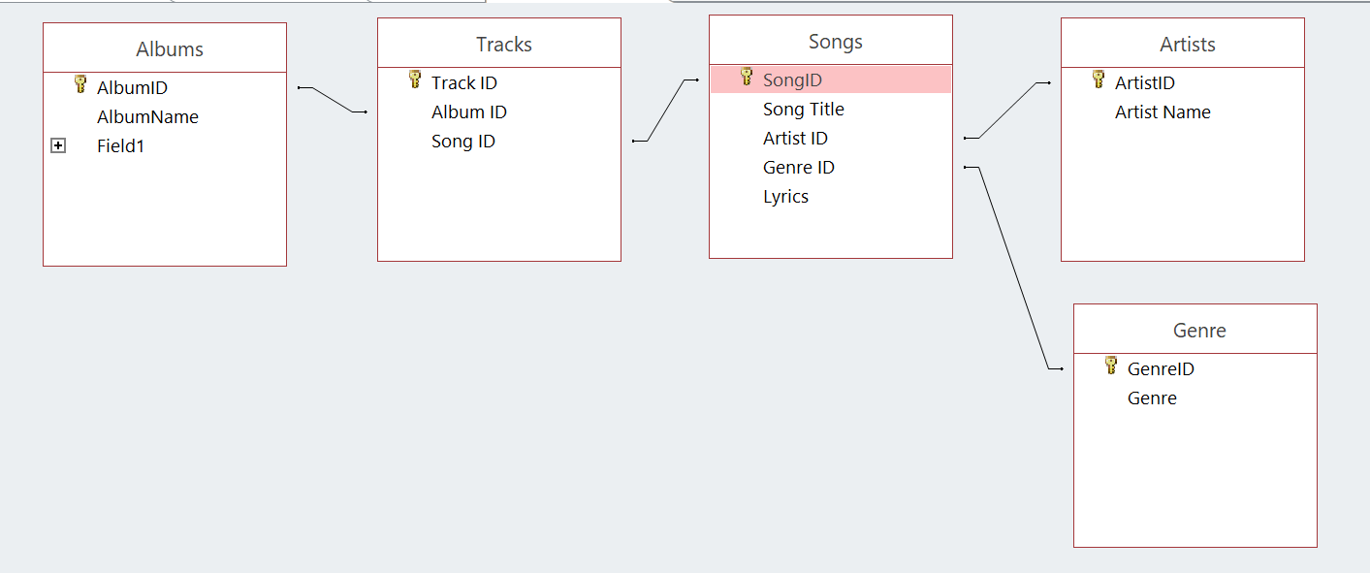

Slide 12
”
Functionality Design
Notes:
Virion: a complete virus particle that consists of an RNA or DNA core with a protein coat sometimes with external envelopes and that is the extracellular infective form of a virus (merriam-webster)
lipid bilayer: is a thin polar membrane made of two layers of lipid molecules. These membranes are flat sheets that form a continuous barrier around all cells.
Endocytosis : is a form of active transport in which a cell transports molecules (such as proteins) into the cell (endo- + cytosis) by engulfing them in an energy-using process.
Viral envelope: Some viruses (e.g. influenza and many animal viruses) have viral envelopes covering their protective protein capsids. The envelopes are typically derived from portions of the host cell membranes (phospholipids and proteins), but include some viral glycoproteins. They may help viruses avoid the host immune system. Glycoproteins on the surface of the envelope serve to identify and bind to receptor sites on the host's membrane. The viral envelope then fuses with the host's membrane, allowing the capsid and viral genome to enter and infect the host.

Slide 13


Slide 14
”
Implementation Approach
The implementation consists of the following:
Music database application:
The application is implemented in C++. We used the application to connect to the database and retrieve the necessary information. An example of the code used to connect to the database as shown in the following slide will imbed an SQL querie by this we will be able to access the database and create, update or view the data stored.
-
Notes:
Endocytosis : It is a form of active transport in which a cell transports molecules (such as proteins) into the cell (endo- + cytosis) by engulfing them in an energy-using process.

Slide 15
Add code sample

Slide 16
”
Implementation Approach (cont.)
The implementation consists of the following:
Music database graphic user interface (GUI):
The GUI is generated using Access forms. This will enable to preview and navigate through the database visually by the user. This is for the average user who dose not have any experience in using coding.
-
Notes:
Endocytosis : It is a form of active transport in which a cell transports molecules (such as proteins) into the cell (endo- + cytosis) by engulfing them in an energy-using process.

Slide 17
Conclusion
This project aim to show the core functionalities in a user friendly GUI and higher level coding application implementation. As a team we managed to reach this level of implementation but at the same time we faced problems that emerged during the preparation of this project. We as a team acknowledge that we did not implement all types of functionality as in real world application. Reasons for that is lack of experience and time as well as the desire to implement additional features in order to enrich the application from more than one angle. However, we feel good about our project and further development of the project is possible, thank you.
Notes:
Maculopapular: Is derived from a fusion of two words, namely, ‘macules’ which is used to refer to small spots on the skin which are discolored and flattened in nature, and ‘papules’ which refers to small and raised bumps. Due to the abnormal redness of the skin due to capillary congestion that is a symptom of this disease
Coalesce: come together and form one mass or whole.
Lymphadenopathy: It is disease of the lymph nodes, in which they are abnormal in size, number, or consistency.
Conjunctivitis: also known as pink eye, is inflammation of the outermost layer of the white part of the eye and the inner surface of the eyelid. It makes the eye appear pink or reddish. There may also be pain, burning, scratchiness, or itchiness. The affected eye may have increased tears or be "stuck shut" in the morning.
Arthralgia: (from Greek arthro-, joint + -algos, pain) literally means joint pain; it is a symptom of injury, infection, illnesses
testalgia: Chronic testicular pain (CTP) is defined as uni- or bilateral, intermittent or continuous testicular discomfort
Orchitis: (or-KIE-tis) is an inflammation of one or both testicles.
Forchheimer spots: are small red spots on the soft palate in 20% of patients with rubella. They precede or accompany the skin rash of rubella. They are not diagnostic of rubella, as similar spots can be seen in measles and scarlet fever.
Prodrome is an early symptom (or set of symptoms) that might indicate the start of a disease before specific symptoms occur. It is derived from the Greek word prodromos, meaning "precursor".

Slide 18
Agenda:
Welcome
Introduction
Related Research
Architecture
Functionality Design
Implementation Approach
Conclusion

Slide 19
Whitworth University
CS 374
Database Project
‘MUSIC DATABASE’

